Slide 1
Global Macroeconomic Landscape for
Fixed Income

Slide 2
Historical Context
 | Equities | Corp bonds | HY bonds | 10-year T | 30-year T
1940-49 | 9.0% | 3.9% |  | 2.7% | 2.4%
1950-59 | 19.3% | 0.2% |  | 0.4% | -0.5%
1960-69 | 7.8% | 0.6% |  | 2.4% | 0.5%
1970-79 | 5.8% | 5.8% |  | 6.1% | 4.5%
1980-89 | 17.5% | 13.2% |  | 12.8% | 12.6%
1990-99 | 18.2% | 8.9% | 11.2% | 8.0% | 8.6%
2000-09 | -1% | 7.4% | 6.5% | 6.4% | 7.6%
2010-19 | 13.6% | 8.2% | 7.5% | 4.1% | 7.2%
2020-23 | 11.3% | -4.2% | 1.7% | -3.1% | -6.1%
Yields now |  | 7% | 9% | 5% | 5%
Financial repression
Inflation and low real returns
Era of globalization
Peak working population?

Slide 3
Performance across cycles
 | 10Y | IG Spread | World Equities | S&P | Commodities
Hiking | 65 | -30 | 11% | 10% | 12%
Peak | -90 | 30 | 5% | 9% | -5%
Cutting | -125 | 100 | -11% | -4% | -8%
Trough | 0 | -75 | 35% | 43% | 17%
10Y: US Treasury 10-year bond yield proxied by GT10 from Bloomberg (change in bps). IG Spread: BICLB10Y Index (change in bps). World Equities: MXWO Index (% return in USD). S&P: SPX Index (% return in USD). Commodities: BCOM Index 9% return in USD). Period analyzed 1989-2022.
For illustrative and discussion purposes only. Past performance is not indicative or a guarantee of future results.
There is no assurance that any projection, estimate or forecast will be realized.
Source: Franklin Templeton, as of 31 March 2023.

Slide 4
Peak rates favor quality fixed income
At the peak
In a cutting cycle
Cycle | 10Y | IG Spread | World Equities | S&P | Commodities
1989 | -70 | 33 | -1% | 11% | 1%
1995 | -99 | 25 | 4% | 9% | -1%
1998 | -175 | 63 | 11% | 19% | -33%
2000 | -90 | 50 | -11% | -9% | 9%
2007 | -45 | 35 | 18% | 15% | -7%
2019 | -60 | -12 | 7% | 9% | -1%
Average | -90 | 30 | 5% | 9% | -5%
Cycle | 10Y | IG Spread | World Equities | S&P | Commodities
1989 | -170 | 45 | 1% | 30% | 5%
1995 | -85 | 10 | 6% | 13% | 9%
1998 | 30 | -10 | 15% | 14% | -10%
2001 | -160 | 15 | -30% | -30% | 4%
2007 | -235 | 400 | -45% | -40% | -35%
2019 | -135 | 175 | -15% | -13% | -20%
Average | -125 | 100 | -11% | -4% | -8%
For illustrative and discussion purposes only. Past performance is not indicative or a guarantee of future results.
There is no assurance that any projection, estimate or forecast will be realized.
Source: Franklin Templeton, as of 31 March 2023.

Slide 5
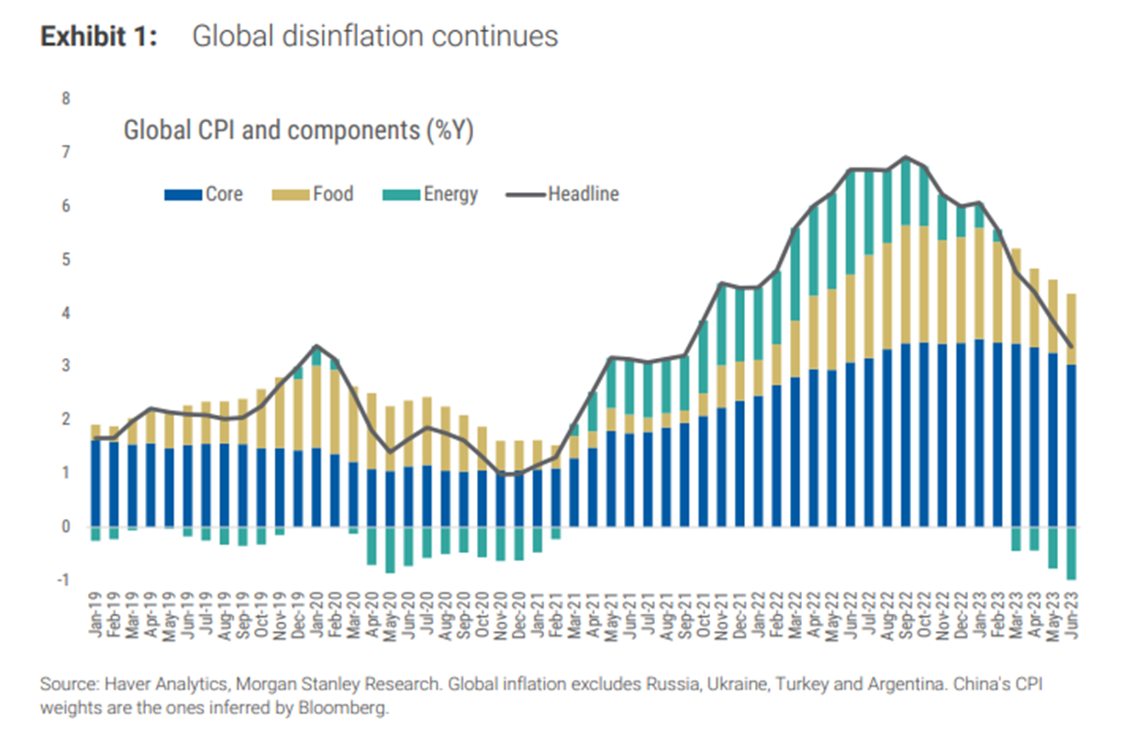
Yield is back, finally
Thanks to inflation
Still elevated at a global level

Slide 6
Unprecedented decline in M2
“Inflation is always and everywhere a monetary phenomenon”
Source: Bloomberg, September 30, 2023
For illustrative and discussion purposes only. Past performance is not indicative or a guarantee of future results.
There is no assurance that any projection, estimate or forecast will be realized.

Slide 7
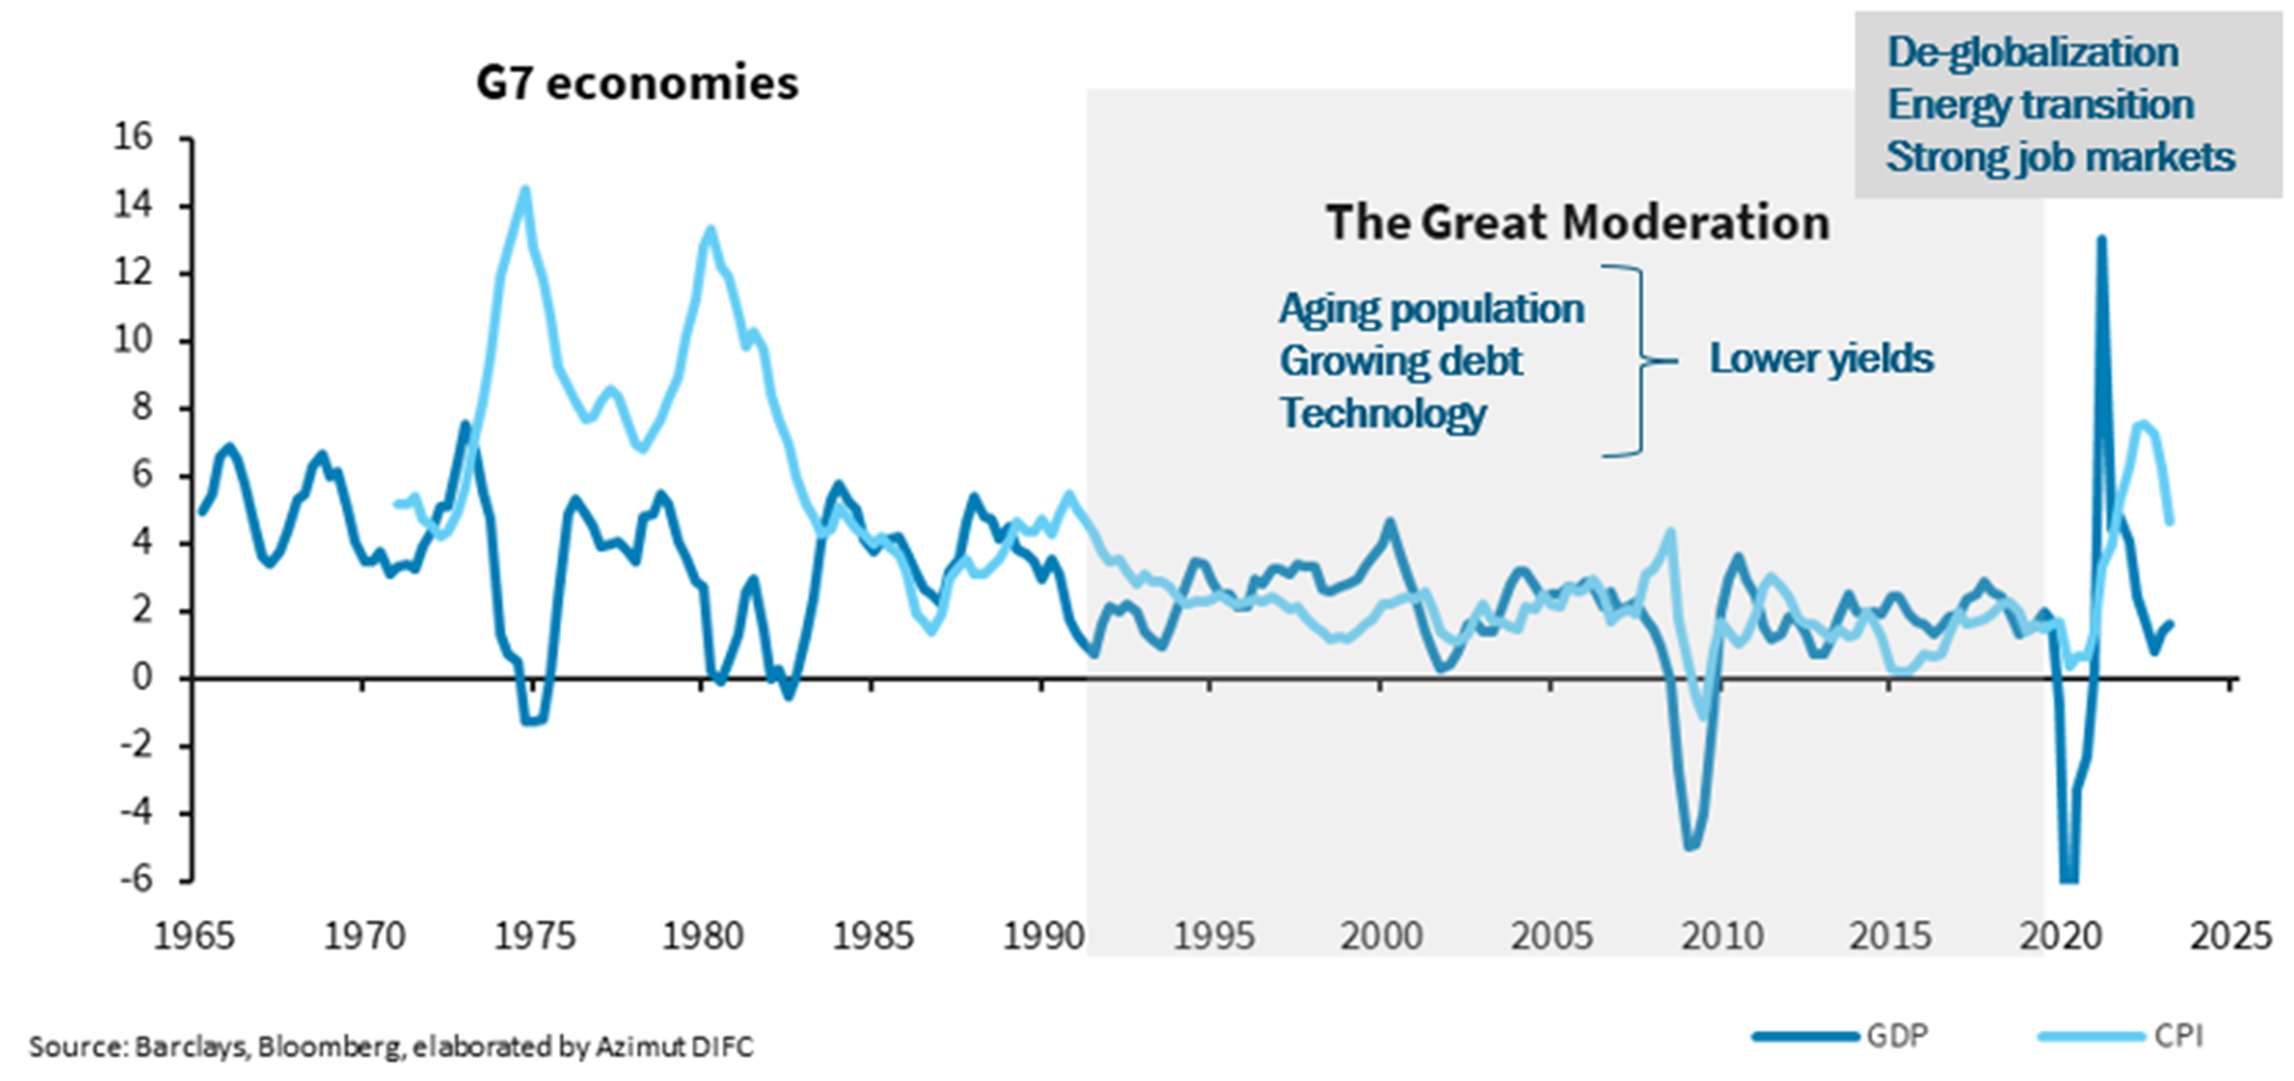
Macro
We will go back to the GM in a few years – AI and Chat GPT the new driver
But in the meantime, de-globalisation, energy transition and strong job market

Slide 8
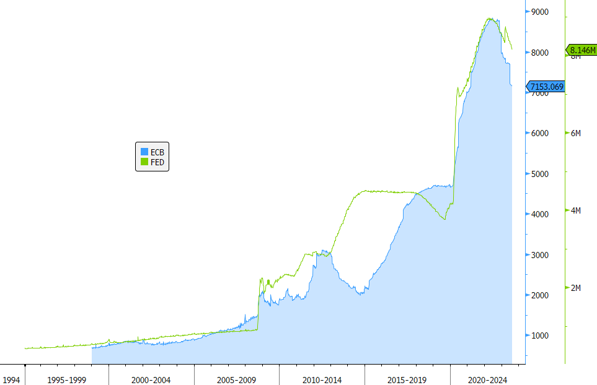
QT: higher-for-longer and less liquidity
Looks like it is continuing, but the debt burden remains high
Source: Bloomberg, elaborated by Azimut DIFC
Steeper curves ongoing

Slide 9
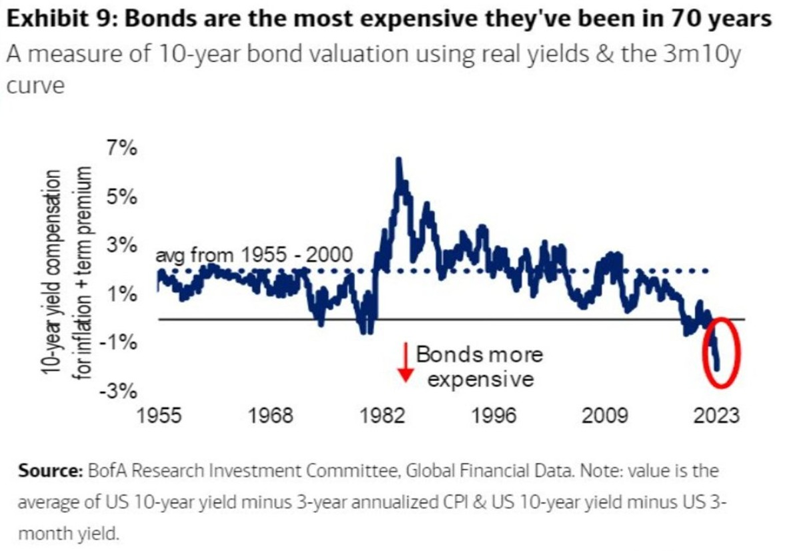
10Y UST – do you believe in an upside scenario?
What should happen to drive 10Y UST meaningfully lower?
Need a final and irrevocable victory over inflation.
The tightening cycle should be over.
Need the good old globalization back.
Well, a lot of work to do….

Slide 10
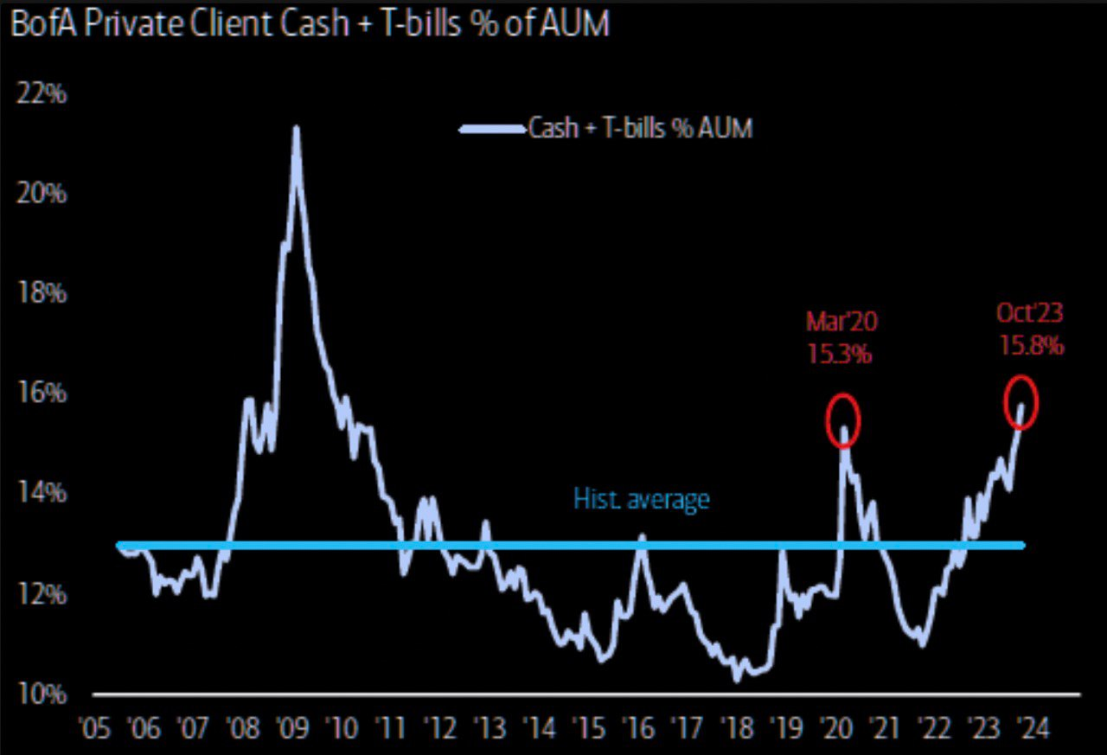
Why bother buying any assets when we have a 5,5% cash yield?
Cash as % of assets is already high, but no crisis yet happened.
More upside for cash ahead when the recession finally happens?

Slide 11
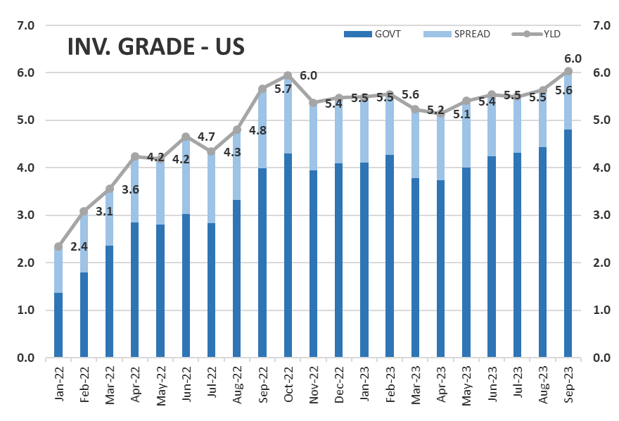
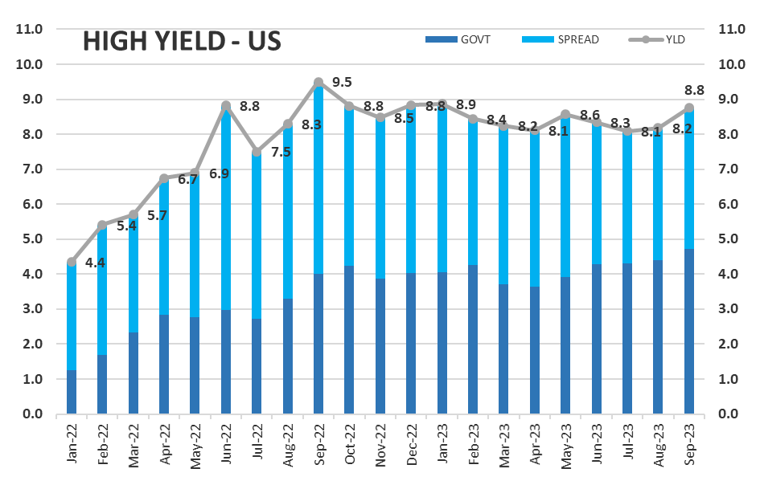
Yield in Credit
Buy CREDIT – perfect mix of Govt Yields and a cushion on top.
Source: Bloomberg, ICE Indices, elaborated by Azimut DIFC
Be careful on the cushion though – is it enough?

Slide 12
Tighter Lending Conditions
“Gradually, then suddenly”
Source: Bloomberg, September 25, 2023.
For illustrative and discussion purposes only.

Slide 13
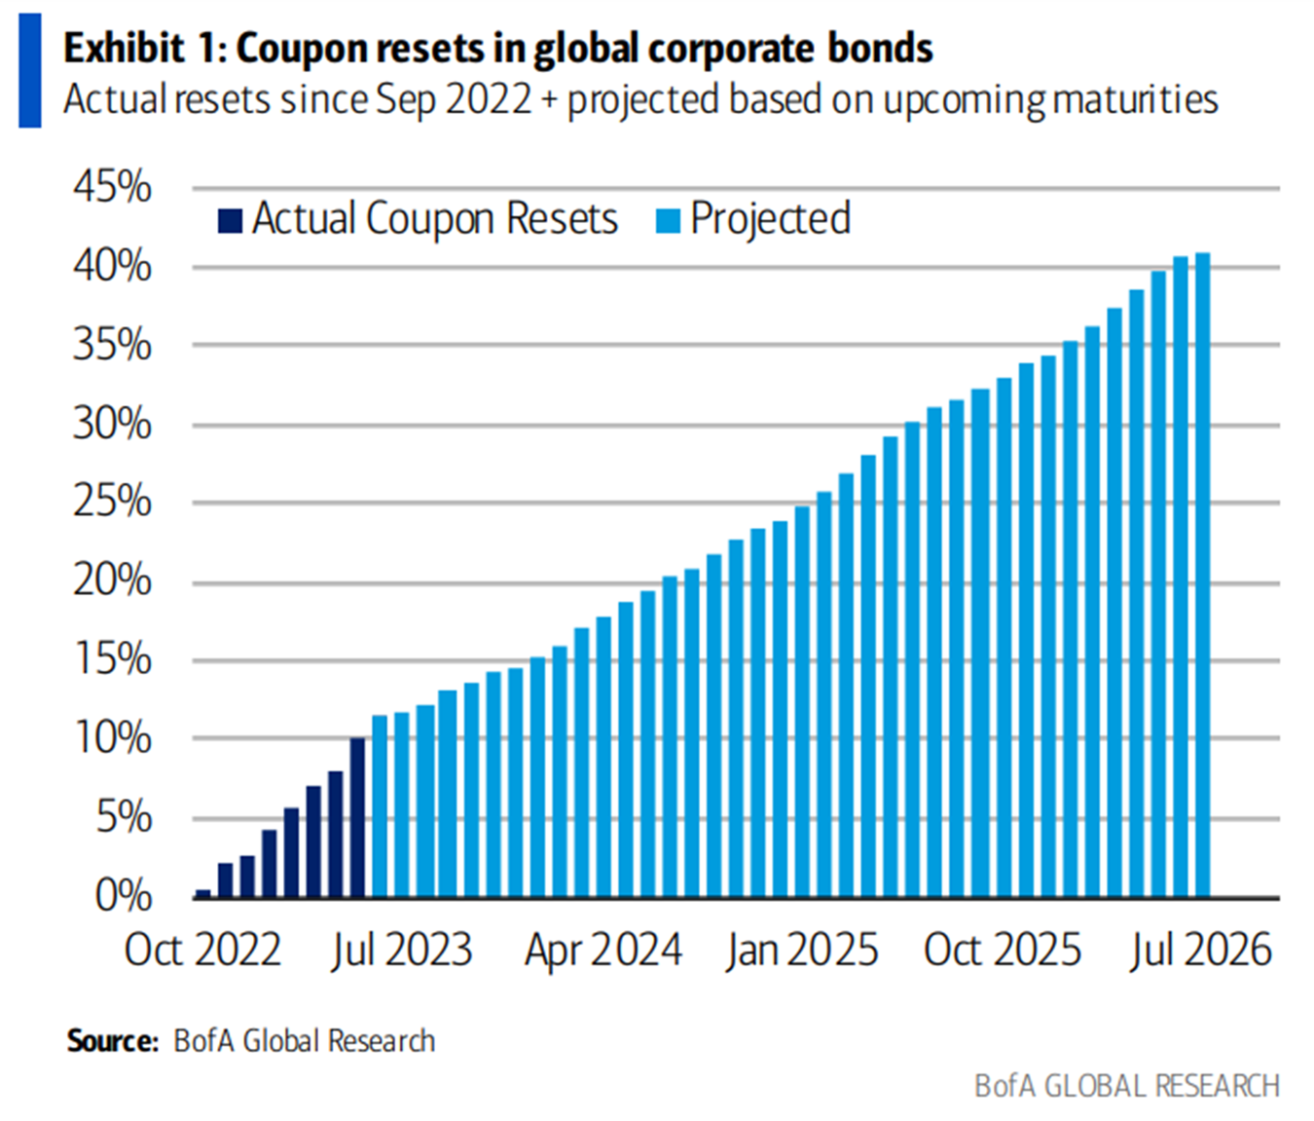
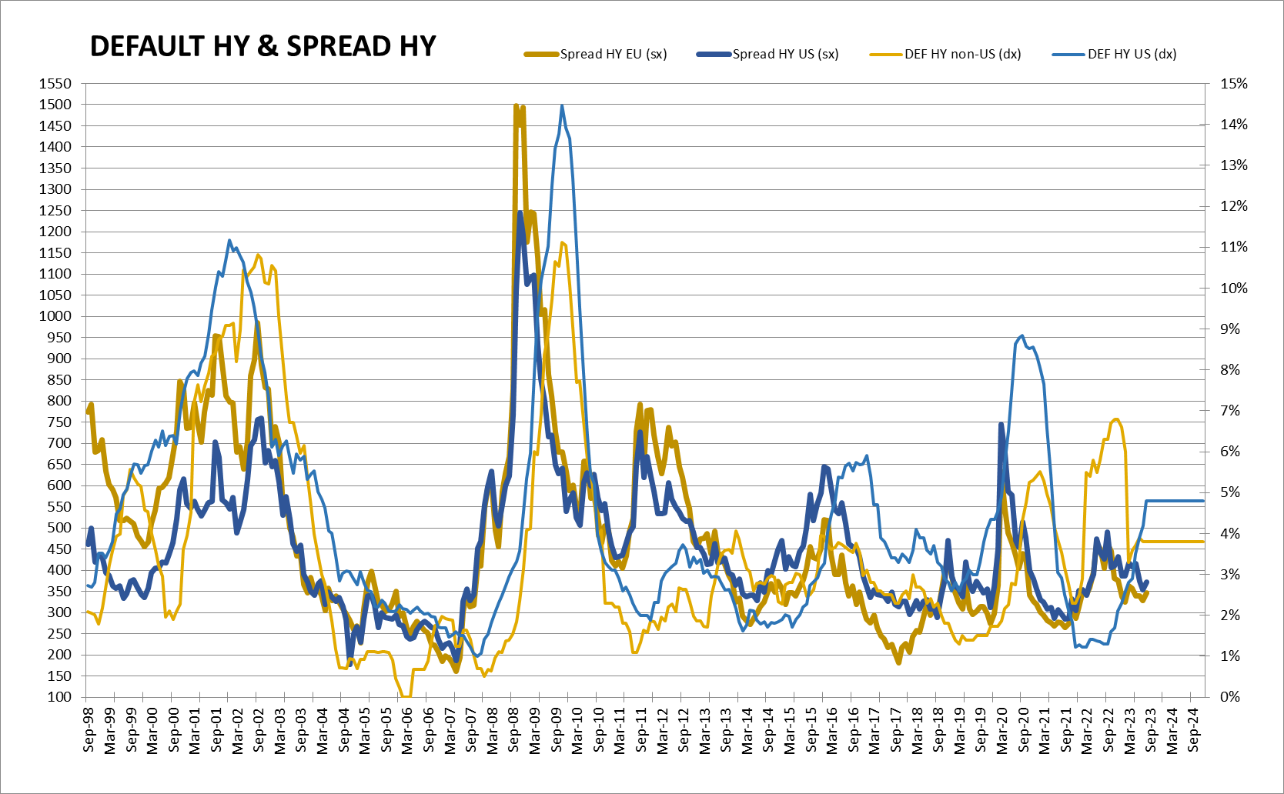
Credit: watch out spreads in the HY space
Could go wider – credit quality is key
Source: Bloomberg, ICE Indices, elaborated by Azimut DIFC

Slide 14
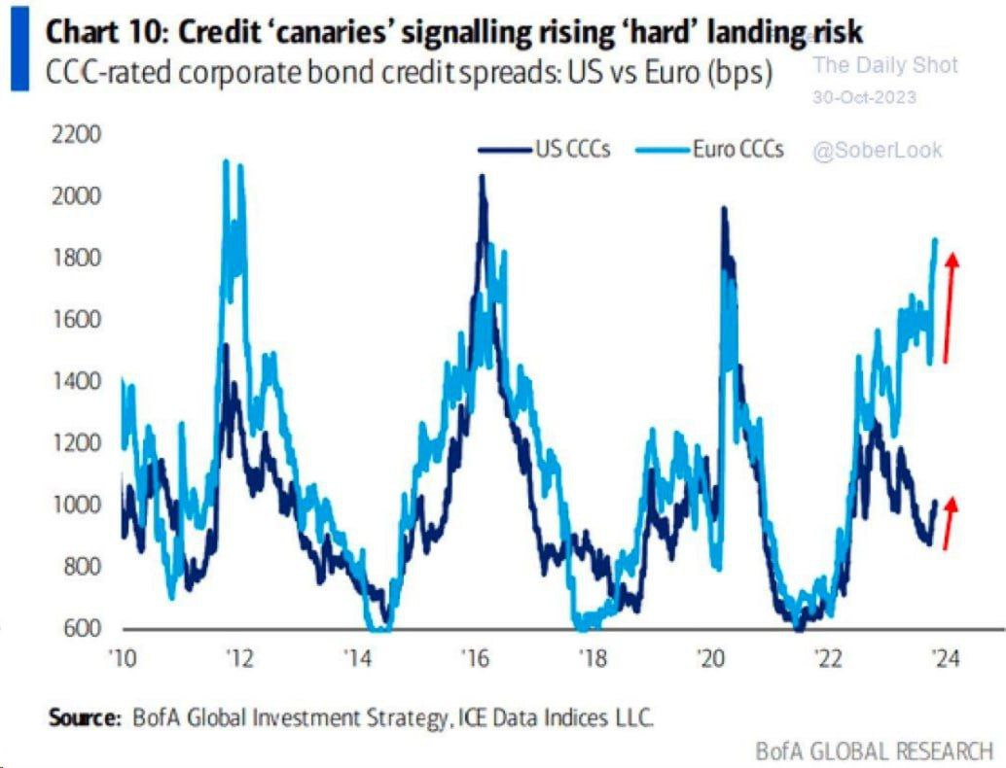
USD High Yield spread – sleeping at the wheel?
EUR CCC spread correctly reflects recession in Europe (while it is hard to call -0,1% GDP decline a “recession”).
USD CCC spread just waits until something breaks?

Slide 15
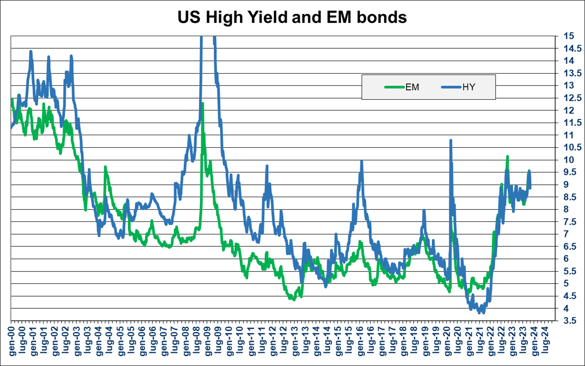
Yield in Credit
EM bonds a good alternative to pure HY bonds
Source: Bloomberg, ICE indices, elaborated by Azimut DIFC

Slide 16
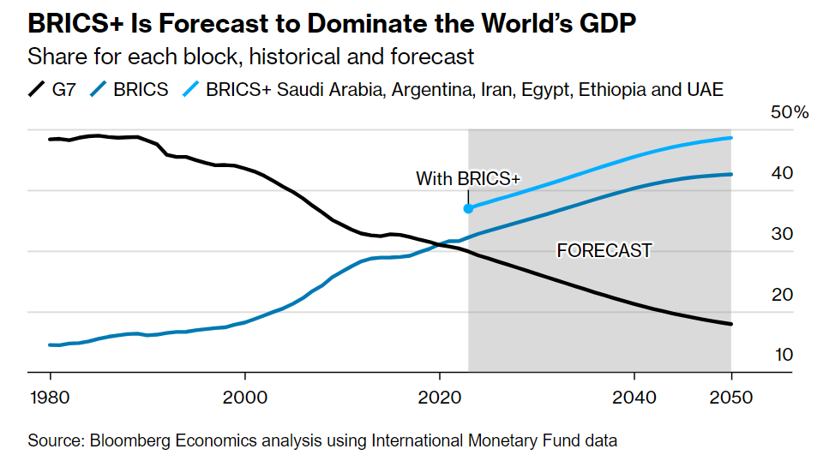
BRICS countries – what a mess
BRICS members are so different:
Russia, Iran – excluded from global financial markets.
Argentina, Egypt, Ethiopia –can't live on their own?
China – de facto macro default on multi-billion homebuilders' debt.
India, Brazil, South Africa, UAE, Saudi Arabia – normal capitalist countries.
Is there a way to play the long-term trend of growing BRICS+ economic domination?

Slide 17
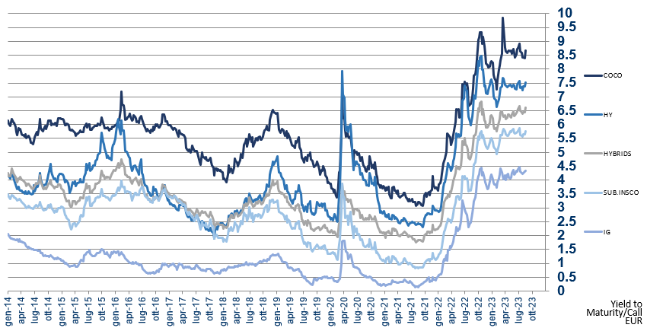
Yield in Credit
Buy Subordinated bonds
Yields are historically attractive and can help absorbing volatility while avoiding default risk typical of pure HY bonds
+1.5% swapping EUR in USD
Source: Bloomberg, ICE Indices, elaborated by Azimut DIFC

Slide 18
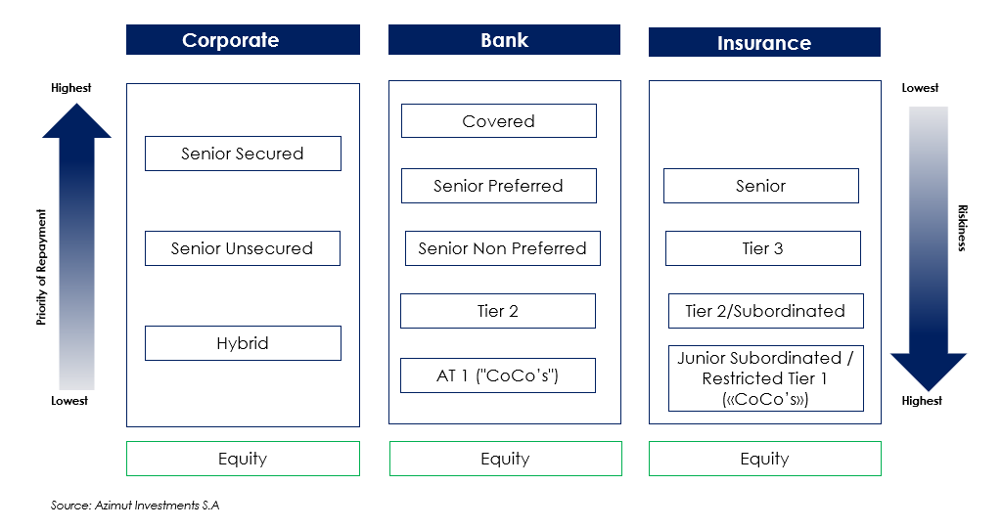
Key Message: Preference for HYBRIDS
Simplified Capital Structure

Slide 19
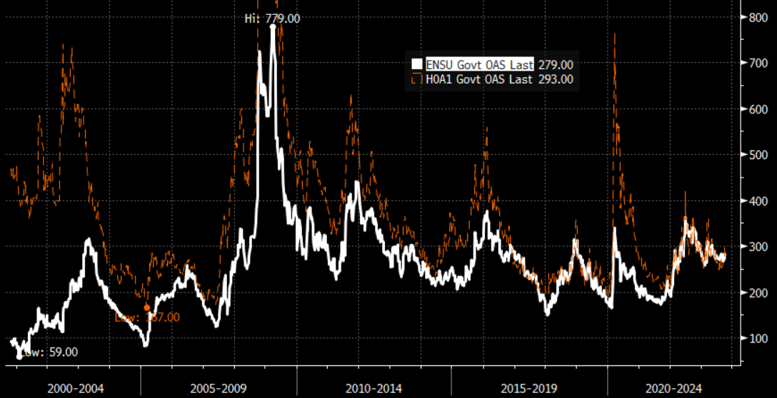

Corporate Hybrid vs BB US High Yield
Key Points
IG-like default risk: hybrid issuers have a higher rating than the hybrid bond itself
HY-like return from strong and well-known IG issuers: credit spread similar to HY but with lower volatility
Option Adjusted Spread Analysis
If afraid of Recession
avoid Default Risk
=
Buy Subordinated Debt from IG issuers
Source: Azimut DIFC, Bloomberg, as of October 2023
ENSU Index: ICE BofA Euro Non-Financial Subordinated
H0A1 Index: ICE BofA BB US High Yield

Slide 20
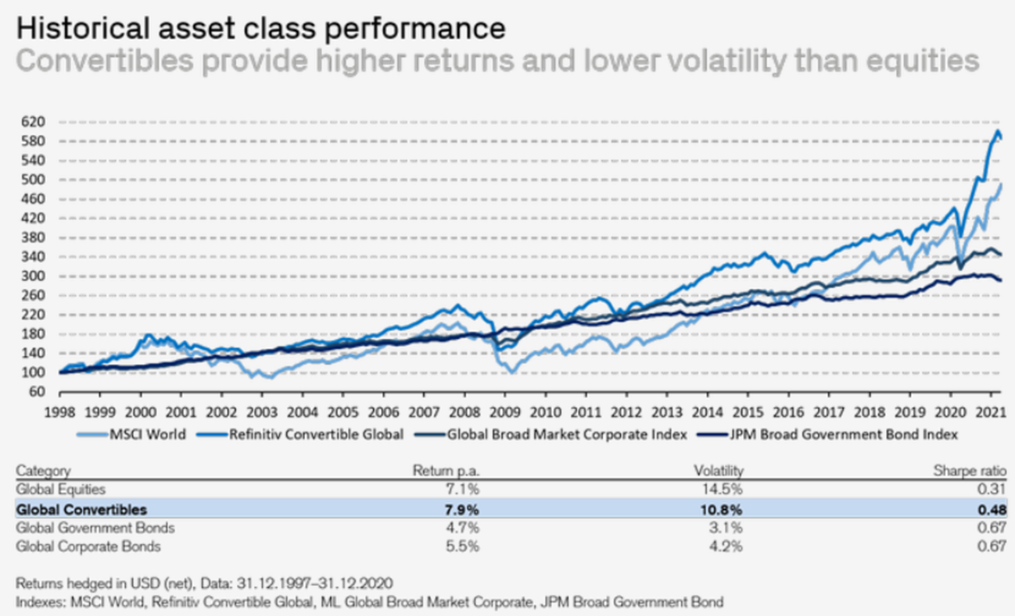
Convertible Bonds
Worth a lot in the asset allocation process

Slide 21
Convertible Bonds
Technical characteristics
Distressed
Bond-like
Balanced
Equity-like
Out of The Money
Share price trades low
CB behaves similarly to a conventional corporate bond
Delta approaches 0
Premium = +70%
At The Money
Share price trades close to the conversion price
Value of CB is more sensitive to a rise in share price than to an equivalent drop in share price
Payoff is more attractive
Delta between 0.4 and 0.6
Premium = 30% to 50%
Parity
Investment Premium
Conversion Premium
Bond Floor
Convertible Bond Price
In The Money
The share price exceeds the strike price
The value of the convertible bond is closed to Parity
Delta approaches 1
Premium = less than 20%
Share Price
Bond Floor: present value of the future cash flows if the conversion option is not exercised
Investment Premium: percentage difference between the convertible bond price and the bond floor
Parity: value of the shares into which the bond can be converted
Conversion Premium: price difference between the bond and parity

Slide 22
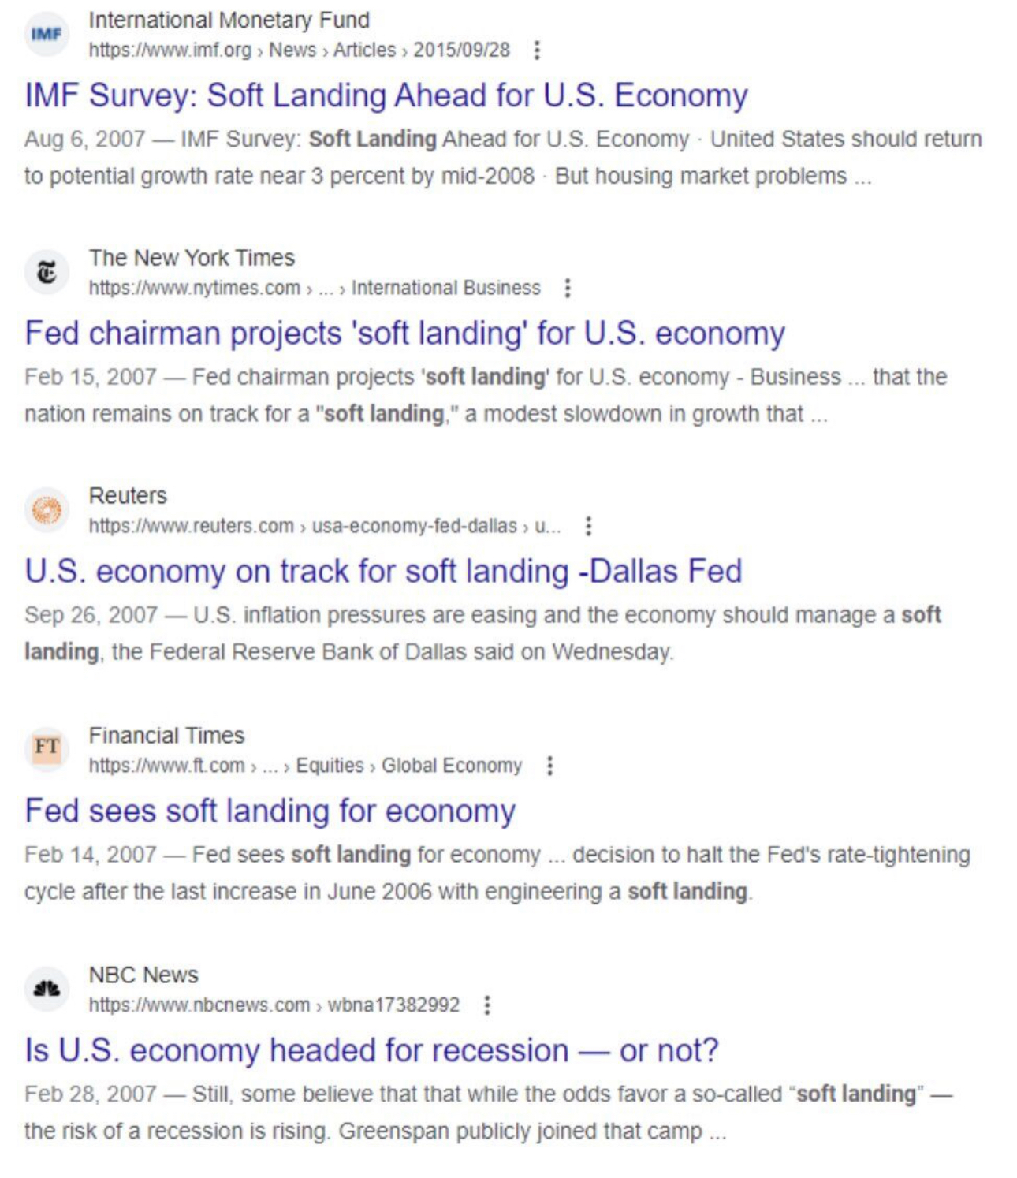
… forecasting is hard
“The Committee reiterated its view that the economy seemed likely to continue to expand at a moderate pace over coming quarters, supported by solid growth in employment and incomes and a robust global economy. Readings on core inflation had improved modestly in recent months. However, a sustained moderation in inflation pressures had yet to be convincingly demonstrated”
- FOMC minutes, September 2007
For illustrative and discussion purposes only.

